Slide 1
Setting Up a Python Data Science Environment
Select Python Data Science Tools
Install Python Using Anaconda
Set Up an Environment Using Jupyter Notebook

Slide 2
Select Python Data Science Tools
Topic A

Slide 3
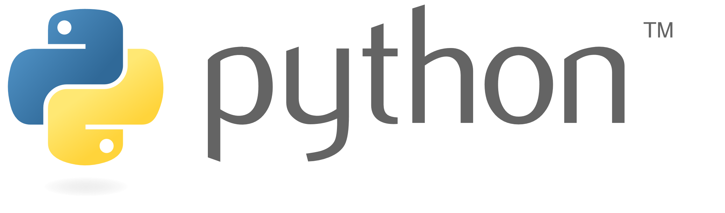
Python and Data Science
Data science: The discipline that involves accumulating, analyzing, extracting value from, and presenting the value of data.
Python has become one of the most popular data science platforms.
Used in both academia and business.
Has largest market share for data science.
Simple syntax, and easy to use.
Especially helpful for data scientists new to programming.
Third-party libraries are the biggest reason for Python's success in data science.
Accessible, yet robust and deep.
Open source.
Continually improved by volunteers.

Slide 4


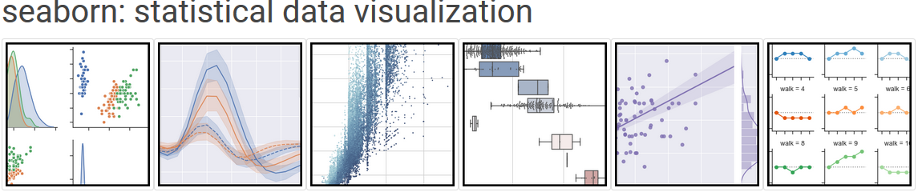



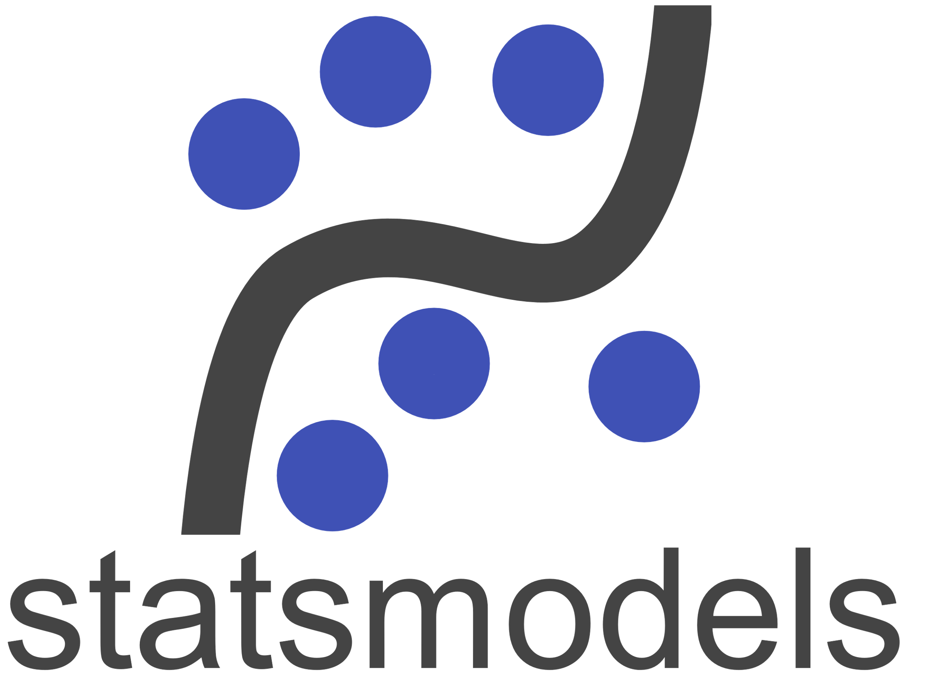

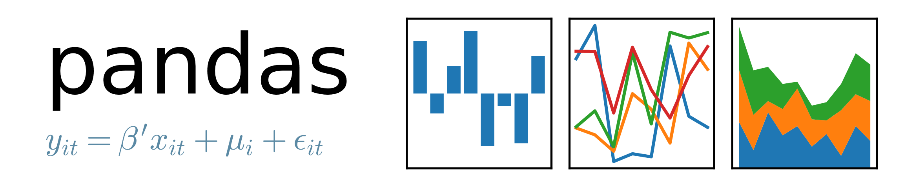
Data Science Tools: An Overview

Slide 5

Reference Documentation
You'll need to consult a library's documentation from time to time.
Reference docs usually include:
Function definition
Parameters
Attributes
Returned values
Simple examples
Reference URLs:
NumPy (https://docs.scipy.org/doc/numpy/reference/)
SciPy (https://docs.scipy.org/doc/scipy/reference/)
statsmodels (http://www.statsmodels.org/stable/api.html)
pandas (https://pandas.pydata.org/pandas-docs/stable/reference/index.html)
Matplotlib (https://matplotlib.org/api/index.html)
Seaborn (https://seaborn.pydata.org/api.html)
Jupyter Notebook (https://jupyter-notebook.readthedocs.io/en/stable/)
Beautiful Soup (https://www.crummy.com/software/BeautifulSoup/bs4/doc/)
Anaconda (https://docs.anaconda.com/anaconda/reference/)
API
Reference

Slide 6

Hardware Considerations
Hardware resources impact data science performance.
May lead to delays, outages, unachievable goals, etc.
Components:
Storage drives for capacity and read/write speed.
Multi-core CPUs for app processing.
GPUs for machine/deep learning.
Factors that prompt evaluation/upgrade of hardware:
Dataset size
Scalability
Types of operations
Time constraints
Virtualization
Take a proactive approach to addressing hardware needs.
Minimizes disruptions during project.

Slide 7

Cloud Considerations
Hardware may be too costly or time consuming.
Offloading to cloud is an alternative.
Cloud is elastic; pay only for what you use.
Unlimited resources on demand.
One or more tasks to potentially offload:
Development
Storage
Processing
Testing
Publishing
You can still use Python environments in cloud.
Example: Set up VM on Amazon EC2 with Python.
Example: Use Jupyter Notebook on Google CoLaboratory.
Downsides:
No true ownership of data.
Security, privacy, and availability concerns.

Slide 8
Guidelines for Selecting Python Data Science Tools
Identify your business needs.
Identify goals of data science tasks.
Identify which libraries might help you achieve goals.
Identify which libraries might warrant investigation.
Consider using NumPy for calculations on numeric data.
Consider using pandas to clean and analyze varied data.
Consider using Matplotlib and Seaborn to visualize data.
Consider installing an environment like Anaconda to streamline development.
Consult reference documentation when you need help.
Consider the effect of hardware limitations on your data science tasks.
Consider how offloading tasks to the cloud may be beneficial.
Consider the risks of offloading tasks to the cloud.

Slide 9
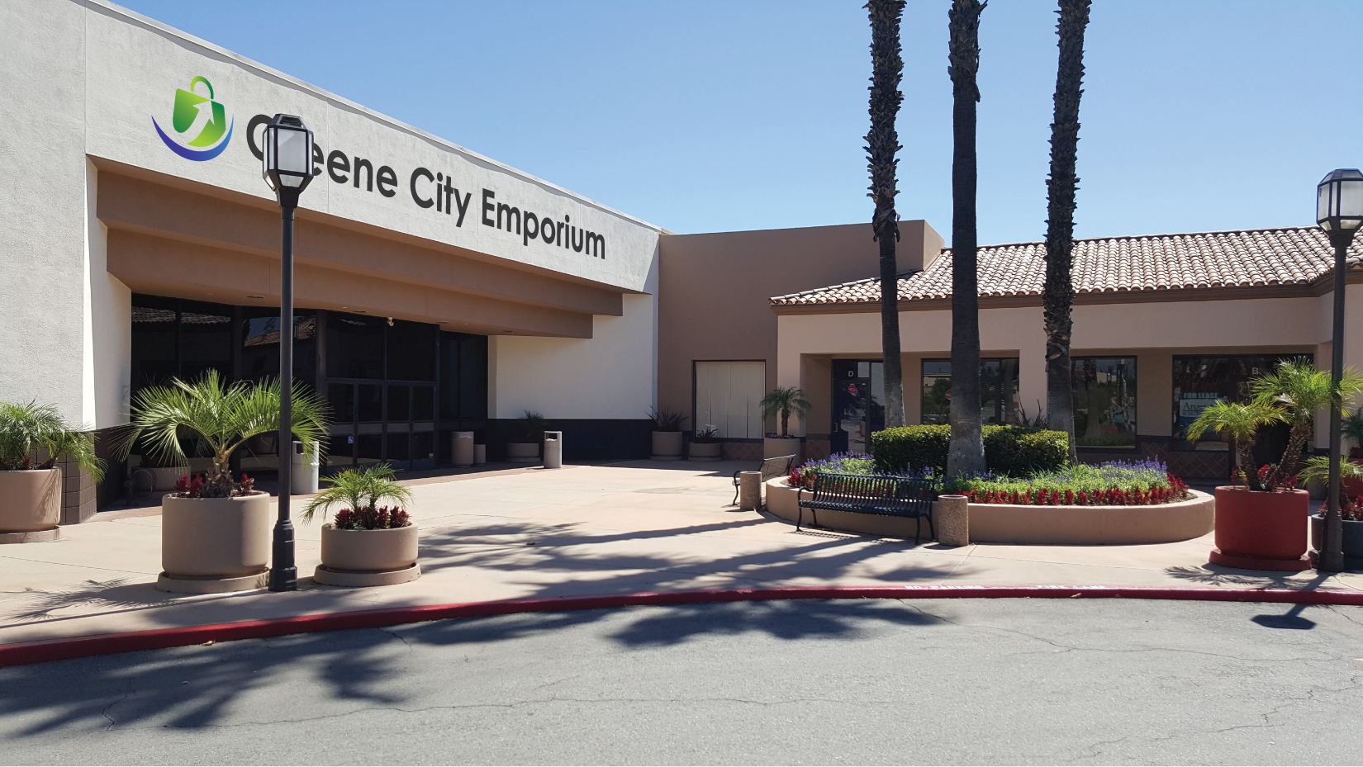
Activity: Selecting Python Data Science Tools
You work for GCE, a small chain of retail stores.
Sells many different types of products.
Currently expanding its stores and products.
You're transitioning from app developer to data analyst.
You need to extract business insights from data.
Before you start, select the right tools for the job.

Slide 10
Install Python Using Anaconda
Topic B

Slide 11
Anaconda
Cross-platform, open source Python/R distribution.
Preferred method of acquiring data science development environment.
Comes pre-packaged with major data science tools.
Enables you to easily acquire more tools.
Already installed libraries:
NumPy
SciPy
statsmodels
pandas
Matplotlib
Seaborn
Beautiful Soup
Thousands of other tools available for download.
IDEs like VS Code.
Data analysis frameworks like Orange.

Slide 12
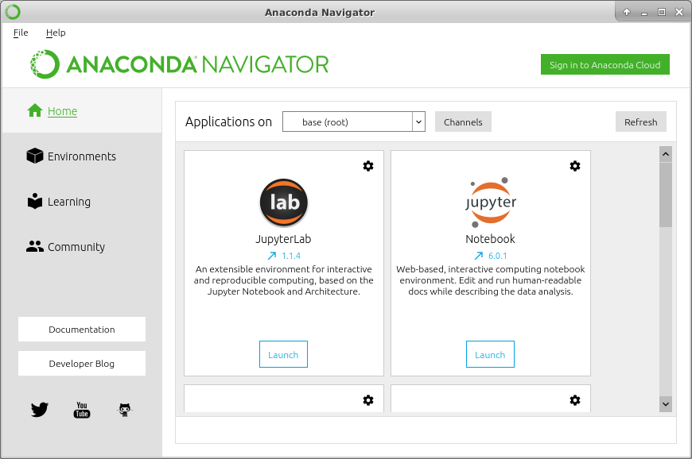
Anaconda Navigator
Manage applications
Manage packages
Find educational resources
Available applications
Interact with the community

Slide 13
Conda
Package managers query, install, update, and uninstall software packages.
Conda is an alternative to pip for managing packages.
Used by Anaconda Navigator on the backend to download/install packages.
Also available as command-line tool.
Major differences between Conda and pip:
pip is Python specific.
Conda is language agnostic; it can work with Python and non-Python packages.
Conda is smarter about how it installs dependencies; it guarantees compatibility.
Conda provides virtual environments; pip does not.
Conda is most useful in environments with non-Python dependencies.
Data science, full stack development, etc.
Conda installs packages only within the Conda environment.

Slide 14
The conda Command
Command-line tool used to work with Conda packages.
May be preferable to GUI in certain cases.
Includes subcommands:
Example: conda search numpy --info
Subcommand | Used To
clean | Remove unused packages.
help | Show documentation for conda command.
install | Download and install packages.
list | List all linked packages.
remove | Uninstall packages.
search | Search for available packages.
update | Update packages to latest version.

Slide 15
Activity: Installing Anaconda
Data analysis team wants to explore Python's capabilities.
Anaconda is a convenient way to get the required tools.
You'll install Anaconda on your local machine to get started.

Slide 16
Set Up an Environment Using Jupyter Notebook
Topic C

Slide 17
IPython (Slide 1 of 2)
Interactive command shell for Python.
Extends functionality of default Python shell:
Runs IPython kernel.
Visually interesting interface.
Support for visualization libraries and GUIs.
Support for parallel computing.
Ability to run OS commands.
Support for magic commands.
Support for ease-of-use features.
IPython started to incorporate more features and languages.
Language-agnostic features spun off into new project.
Focus is back on interactive Python.

Slide 18
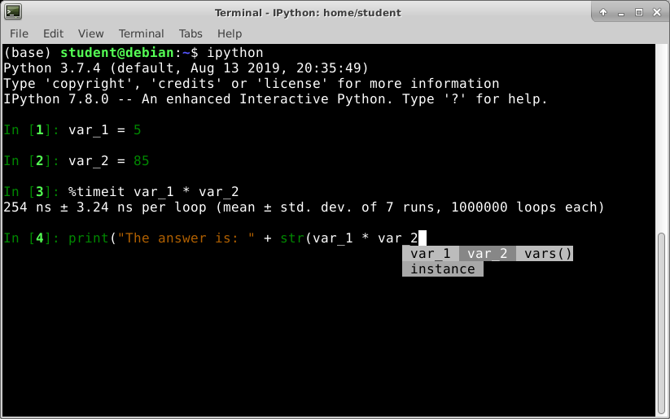
IPython (Slide 2 of 2)
Magic command
Code completion

Slide 19
Project Jupyter
Inherited IPython's language-agnostic features.
Supports Julia, Python, R, and over 100 other languages.
Most prominent application is Jupyter Notebook.
Other features/apps include:
Kernels for each supported language.
Client that manages kernels.
Qt console for shell integration with kernels.
Voilà for publishing Notebook documents.
JupyterHub for multi-user Notebook service.
JupyterLab for a flexible web-based interface.

Slide 20
Jupyter Notebook
Core app of Project Jupyter.
Execution environment deriving from IPython Notebook.
Provides web-based interface for working with code in a configurable document.
Supports rich media, explanatory markup, modular execution, etc.
Single platform for working with every step of execution process.
Popular for teaching concepts, but also used in testing and production.
Runs as a web server.
Default: localhost on port 8888.
User connects through browser.
Can also run publicly and through HTTPS.

Slide 21
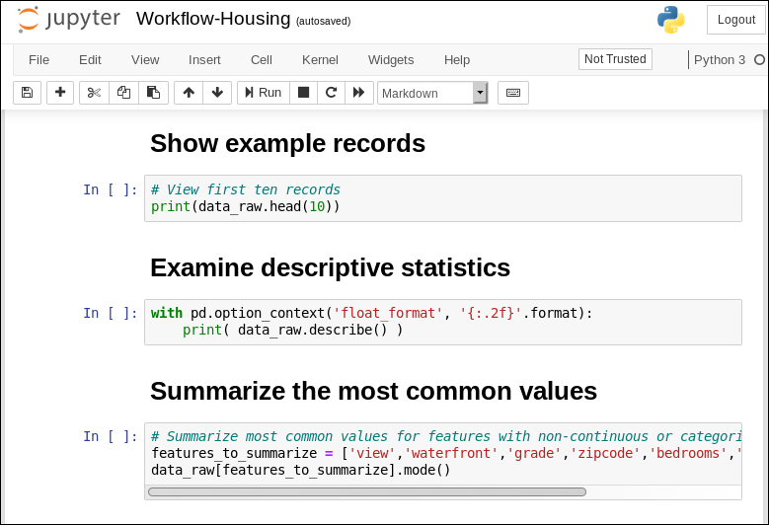
Notebook Documents (Slide 1 of 2)
Menu
Cells

Slide 22
Notebook Documents (Slide 2 of 2)
Typical workflow:
Enter block of code in cell.
Add explanatory markup (optional).
Execute code in cell.
Enter code in next cell, repeat process.
Execution environment maintains state.
Can receive textual or graphical output after execution.
Documents are just files in JSON format.
Saved with .ipynb extension.
Easy to share with others.

Slide 23








Kernels
Output
Input

Slide 24
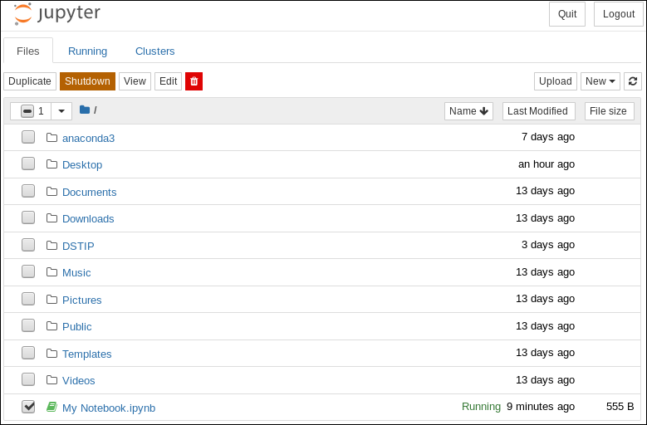
Jupyter Notebook Dashboard
Menu for current selection
Directory structure
Running file

Slide 25
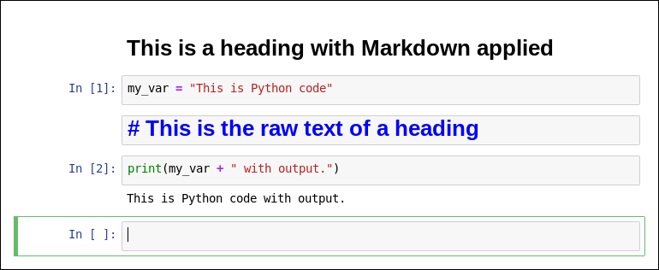
Notebook Document Cells
Markup cell
First code cell
Second code cell (with output)
New code cell

Slide 26
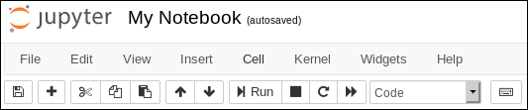
Notebook Document Menu
Menu bar
Toolbar

Slide 27
Document Menu Bar
Category | Includes Commands For
File | Creating, opening, saving, renaming, converting, and closing documents.
Edit | Cutting, copying, pasting, deleting, splitting, merging, and moving cells. Finding and replacing text.
View | Hiding/unhiding screen elements. Toggling line numbers.
Insert | Inserting cells.
Cell | Running cells, changing cell type, and managing cell outputs.
Kernel | Interrupting, restarting, reconnecting to, and shutting down the kernel. Changing the kernel.
Widgets | Saving and clear the state of widgets.
Help | Accessing tutorials and reference docs for Jupyter Notebook and libraries.

Slide 28
Activity: Setting Up a Jupyter Notebook Environment
For now, the team needs to run Python interactively.
Integration with a large-scale development platform will come later.
Jupyter Notebook can help the team process data and see the results.
All in a single interface that's easy to use and edit.
You'll test Jupyter Notebook to see if it meets the team's needs.

Slide 29
Would you consider using Jupyter Notebook in your own job? Why or why not?
What other non-Python data analysis tools have you used in the past, or still currently use?

